Slide 1


Minor Project Title: Mentor-Matrix
Presented by:
Eshan Singh
500091330 Batch -01
Course -B.tech CSE CSF

Slide 2
Introduction.
A web portal that seamlessly connects students with qualified mentors, empowers teachers to showcase their skills, and simplifies scheduling hassles. Introducing Mentor Matrix, a groundbreaking project designed to unlock educational potential for everyone.

Slide 3
Problem Statement.
Student Struggles: It's often challenging for students to find suitable mentors, particularly when they lack specific guidance or clear pathways to connect with experts.
Teacher Challenges: Teachers frequently face administrative burdens, limited platforms to showcase their skills, and inefficient communication channels with students.
Missed Opportunities: Despite the potential for impactful mentoring relationships, inadequate tools and processes often hinder their development.

Slide 4

Objective of the project.
Our project aims to revolutionize student-teacher mentorship through a user-friendly web portal that leverages innovative technology.
This platform will seamlessly connect students with qualified mentors based on expertise and interests, fostering stronger relationships and maximizing the potential for academic and personal growth.

Slide 5
Tech Stack.
Frontend
React Native
React
Expo Asset Library
Backend
Node.js
Express.js
Firebase Storage
Database
Firebase Realtime Database
IDE
VS-Code
Version Control
GitHub

Slide 6
Methodology.
Requirement Analysis:
Conduct thorough analysis and understanding of the requirements provided for the Mentor-ship portal.
Integrating Agile practices with a user-centered design approach. By prioritizing iterative development, continuous feedback, and cross-functional collaboration, we aim to create a dynamic and responsive application
Design Phase:
Design the app's UI components, including layouts, navigation, and user interfaces for each feature.

Slide 7
Methodology (contd).
Development Iterations:
Develop core functionalities and implement features for Profile Creation, and interaction functionality.
Implement mechanism Develop alerts for error and console logs.
User Testing and Quality Assurance:
Ensure the security and integrity of the system by performing vulnerability assessments and penetration testing.
Address any issues or bugs identified during testing promptly to maintain the stability and reliability of the system.
Documentation and Training:
Prepare comprehensive documentation covering system architecture, software requirement specifications.
Provide training sessions to familiarize them with the operation and maintenance of the system.
.

Slide 8
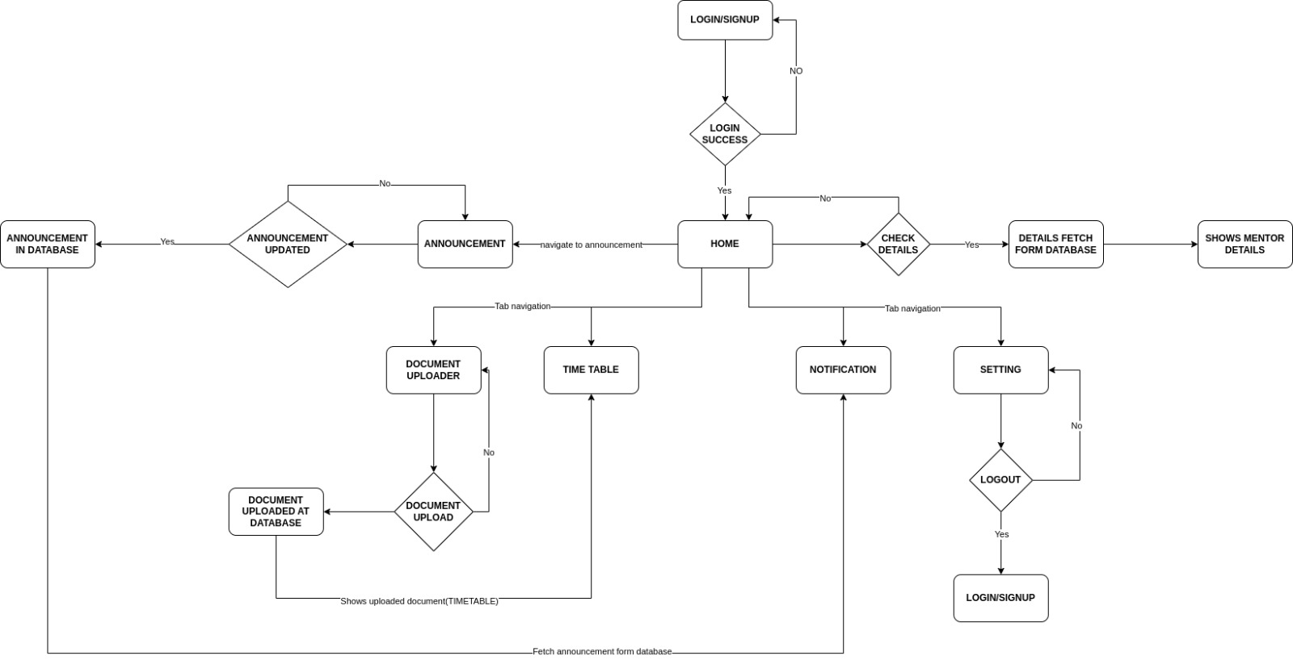
Activity Diagram.

Slide 9
Implementation.
System Design and Architecture: Design the overall system architecture, including database structure, user interfaces.
User Interface Design: Develop a user-friendly web-based/mobile based interface using modern frameworks through React and React Native.
Backend Implementation: Utilizing Node.js for backend development, ensuring robustness and scalability. Handling user requests for submitting and retrieving data.

Slide 10
Implementation (contd).
Data Modelling: Design a No-SQL Realtime-database using Google Firebase and Firestore to store user profiles and announcements ensuring efficient data storage and retrieval.
Security Implementation: Implementing security measures to protect user data, prevent unauthorized access, and ensure data integrity. Implement user authentication and authorization mechanisms, including multi-factor authentication if necessary.
Testing and Validation: Perform Application testing to ensure proper communication between frontend and backend components

Slide 11
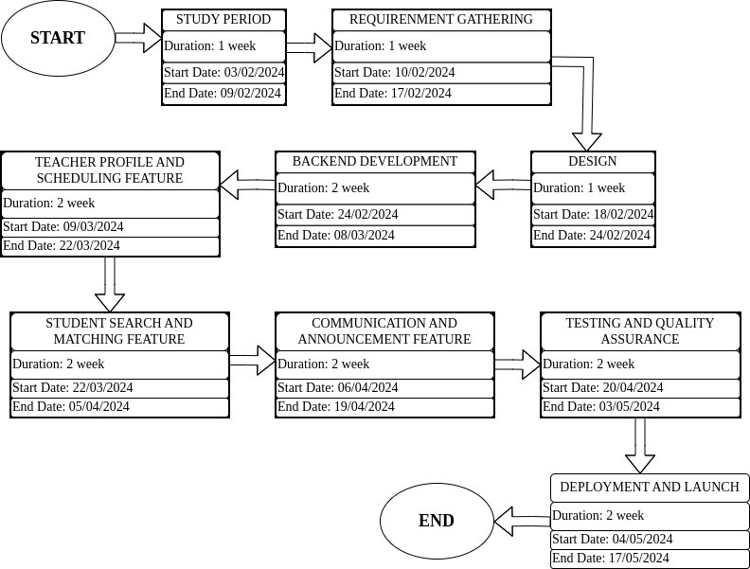
PERT Chart.

Slide 12
SWOT Analysis.
Strengths | Weaknesses
Innovative Concept | Initial Learning Curve
User-Friendly Interface | Dependency on Internet Connection
Continuous improvement
Utilization of Modern Technologies
Opportunities | Threats
Market Expansion | Changing User Preferences
 | Changing User Preferences:

Slide 13
References.
[1] h t t p s : / / w w w . m e n t o r c i t y . c o m /
[2] h t t p s : / / w w w . m i c r o m e n t o r. o r g /

